Slide 1
Selecting Seeds for the Home & Market Garden
Ellie Andrews
Plant Health Management graduate student
The Ohio State University

Slide 2
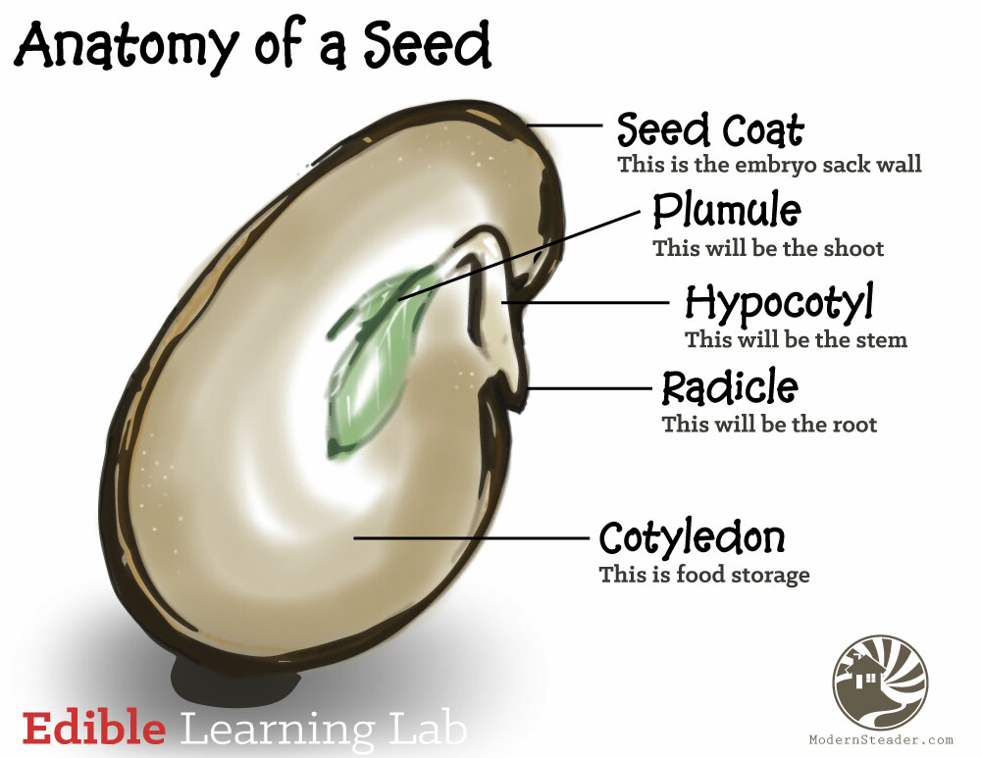
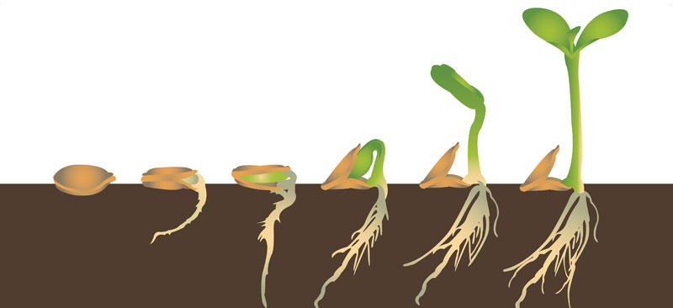

Slide 3
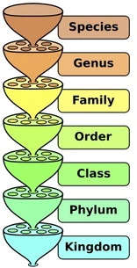
Plant Varieties
Plant species: generally speaking, the largest group of organisms in which two individuals can produce fertile offspring
A unit of biological classification
Reflects a similarity of genetic material that shows up as similar characteristics
Plant variety:
The rank right below species
Can be found in both nature and in plant breeding guided by people
Variety


Slide 4
Biodiversity
There are countless different varieties of plant seeds to choose from
The reason: natural selection!
Through sexual reproduction, the genetic material of two organisms is combined to make unique progeny
Mutations naturally occur that often lead to new traits being expressed in the progeny
Over time, only some of these traits end up (often randomly) helping the organism survive in their particular environment & needs for survival, increasing the organism’s fitness
If the organism can survive and reproduce, it can pass along its traits to the next generation
Changing environmental circumstances and continual recombination through reproduction leads to genetic variation
This process contributes to the immense diversity of plant (and animal) life all around us.
Notes:
Examples: Drought tolerance for plants.

Slide 5
Traditional Plant Breeding
People have guided the process of selection in plant seeds for millennia
Examples:
oak, hickory, maple forests SE OH
every fruit/veggie/grain we eat today
Over time, people repeatedly selected seeds that work well in their particular context: climate, soil type, disease pressure, culture & culinary interest
This is how people develop popular varieties

Slide 6
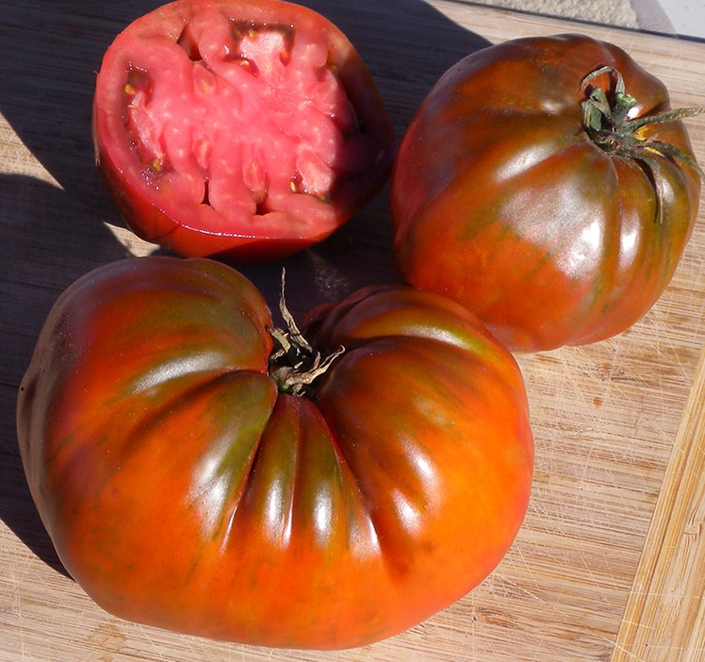
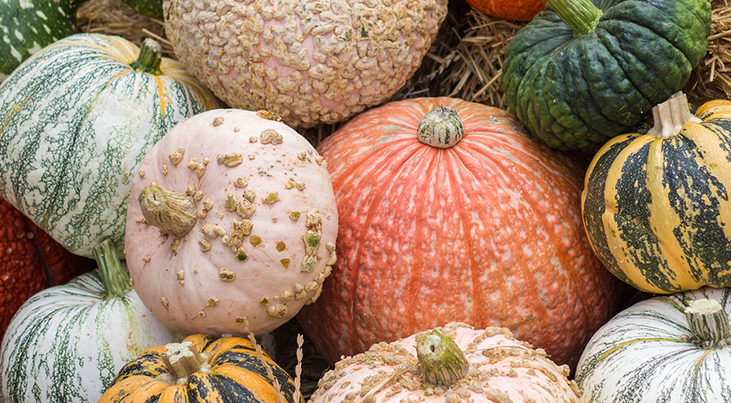
Heirlooms
Fruit, flower, or veggie varieties generally over 50 years old
Open-pollinated: no restrictions on the flow of pollen between plants, done by wind or insects
Seeds will produce plants that generally resemble parent heirlooms, not much genetic variation among progeny
Many varieties preserved and handed down by home gardeners and regional farms from year to year
Some seeds traveled with immigrants
Some heirlooms are commercially bred on a larger scale
Can find them at farmer’s markets, CSAs, some grocery stores

Slide 7
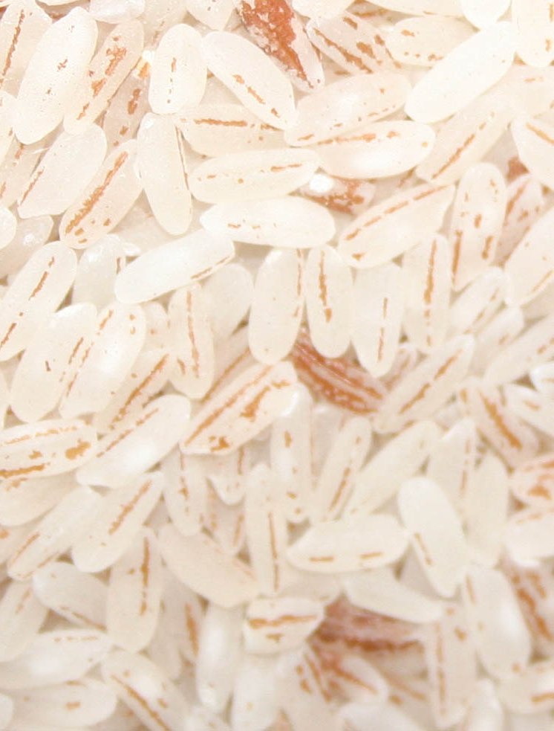
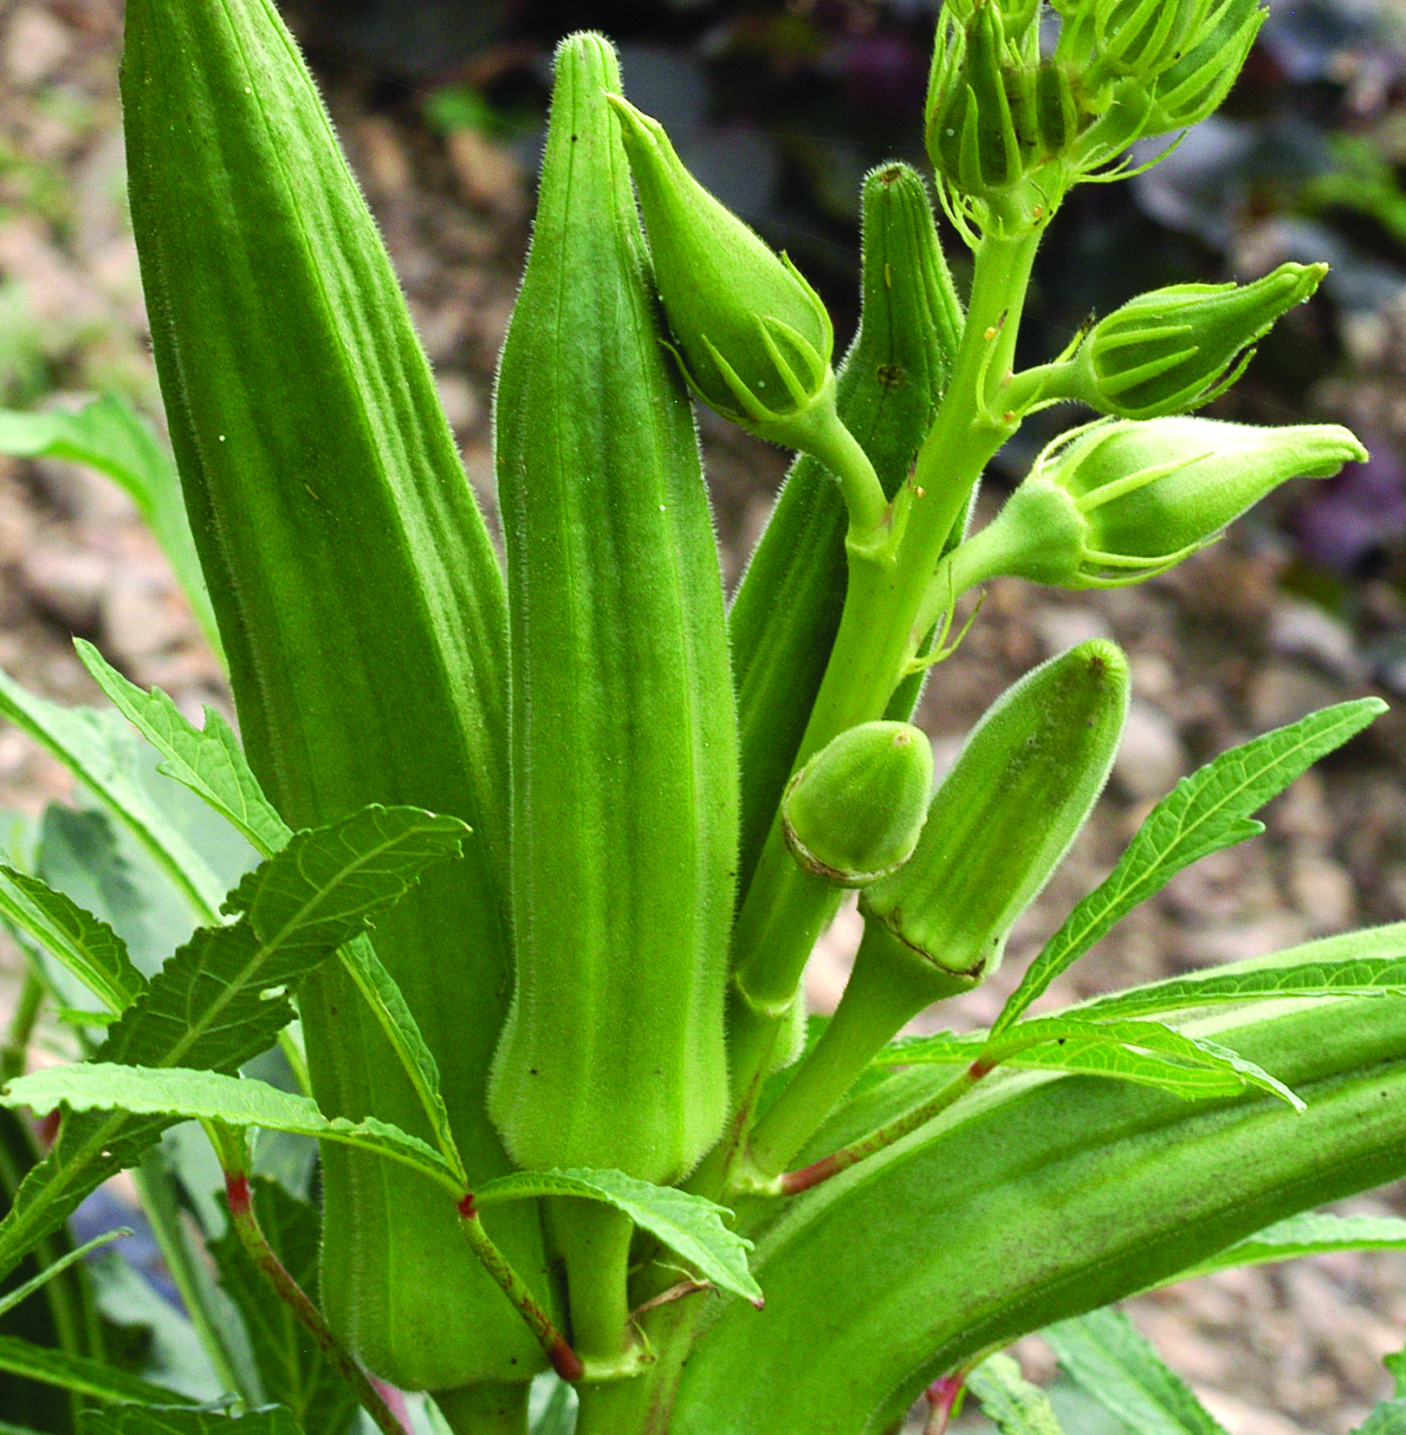
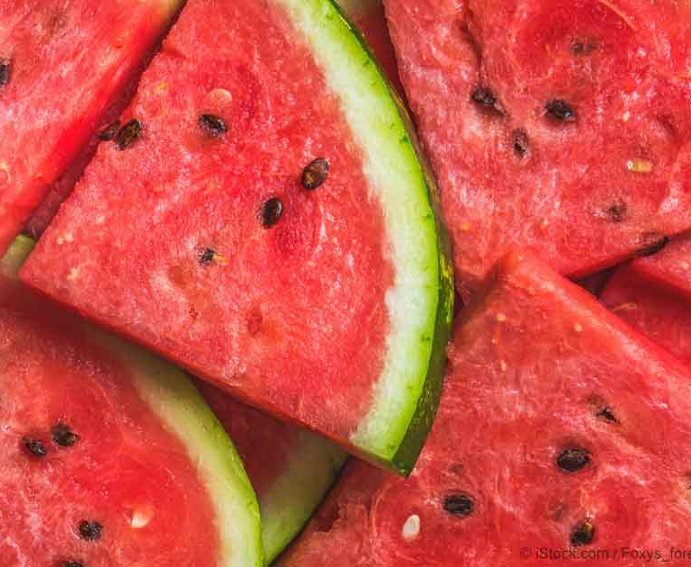
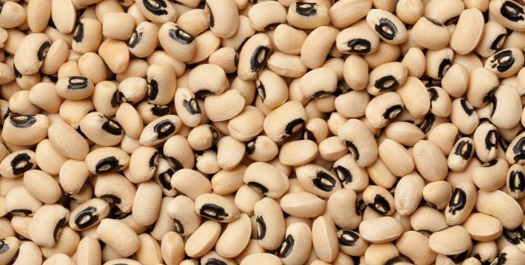
Examples
Many Africans who were forced into slavery in the Transatlantic save trade brought important heirloom seeds with them to help sustain them & maintain a link to their home
This had a huge impact on American cuisine
Examples: rice, okra, black-eyed peas, sesame, watermelon

Slide 8
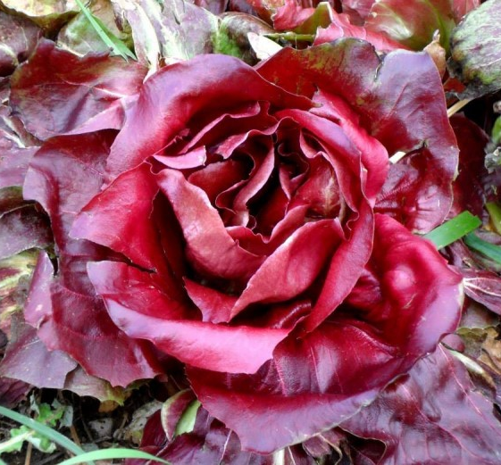
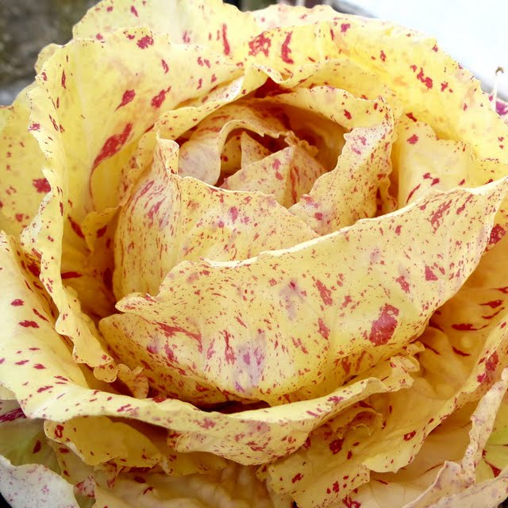
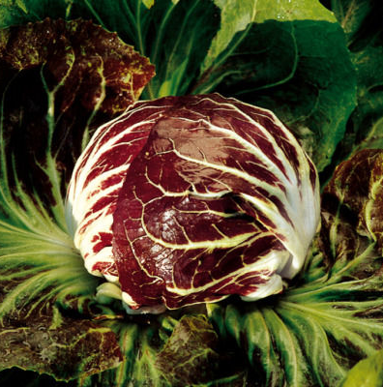
Many radicchio varieties are named after the villages in northern Italy where they originate
Gorizia
Castelfranco
Chioggia

Slide 9
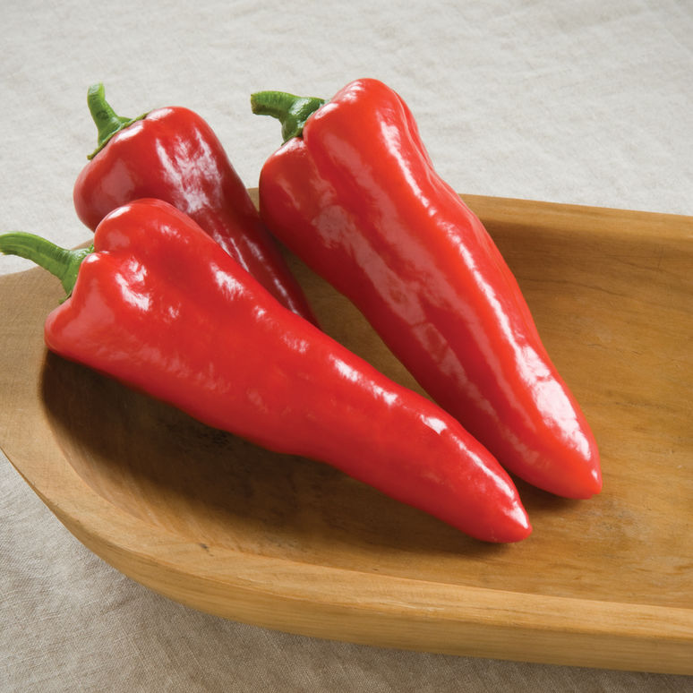
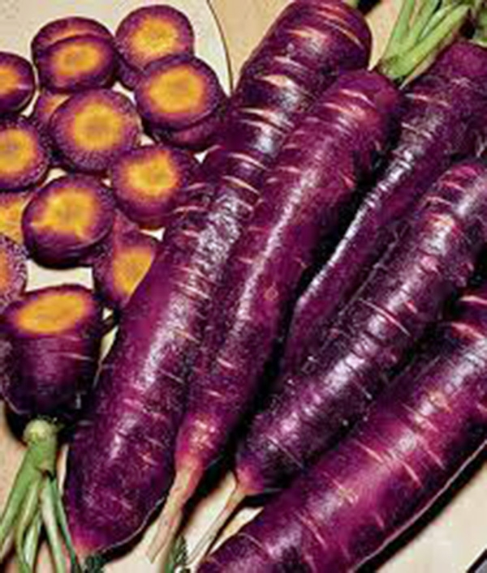
Hybrids
Created when people deliberately cross-pollinate two varieties of a plant through traditional plant breeding
Goal is to produce offspring with certain desired traits of the parent plants, such as cold tolerance
Usually takes many years to develop
Labeled “FI”: the first filial
Most of the veggies in a supermarkets are hybrids
NOT GMOs: genetically modified organisms are engineered by scientists at the molecular level, not thru breeding

Slide 10
Things to keep in mind when saving seeds
Open-pollinated variety: if isolated from other varieties of their species, it will produce seed that’s genetically “true to type,” meaning seed will be similar to parent
Uniform genetic line
All heirlooms are open pollinated
If you want to save seed, only plant one kind of heirloom variety of that species to avoid accidental cross-pollination, and choose seeds from the very best plants
Hybrids are formed when open-pollinated varieties are deliberately crossed within the same species
Variable genetic line
If you save seeds from F1 hybrids, the next generation will probably have different traits, will not be “true to type”

Slide 11
Heirlooms | Hybrids
+ many have rich flavor and unique aesthetic appeal | - some older varieties can be less flavorful and less colorful
+ regional and cultural significance, family history | - less significant family, regional, cultural history
+ can save seed and produce true-to-type progeny | - can’t save seed and expect progeny to resemble parent plants
+ generally cost less than hybrids | + many options for beneficial qualities
-more susceptible to diseases | + more options for effective disease resistance
-lower-yielding, less vigorous | +higher yielding, more vigorous
-inconsistent size, quality, and timing, some produce may be unmarketable | +uniformity & consistency of size, quality, timing of harvest

Slide 12
So how to choose?
Do what works best for you. If you’re curious, try out both!
You can trial different kinds of heirloom and hybrid varieties and see what works well in your environment and context.
soil type
weather trends
moisture level
time of year grown
disease and pest pressure
amount of time you want to put into maintenance
harvest timing
end product goals & marketability

Slide 13
Traits to consider
Cold tolerance
Storage ability
Color & taste
Drought tolerance
Habit
Vigor
Resistance to plant pathogens
Size

Slide 14
Host Plant Resistance
Some varieties have genetic material that codes for resistance to certain pathogens
This happens in nature through random genetic mutations that end up helping the plant survive
Plant breeders can deliberately develop hybrid varieties that have resistance to certain pathogens
Resistance is either due to
An R-gene: one gene gives resistance to a specific pathogen
Quantitative trait loci: several genes give resistance to a broader range of pathogens
Very low maintenance way of managing plant pathogens
Highly recommended if you know you’ve got disease pressure

Slide 15
Integrated Management
Selecting seeds for traits you want is a very valuable tool! But of course, more things need to happen to have healthy plants.
Use an integrated approach to plant health management
Choose a good environment to grow: good drainage, full sun, workable soil, good air flow, mostly flat
Soil fertility: organic matter, aeration, irrigation, cover crops, balanced nutrients
Cultural practices: weeding, mulching, pruning, trellising
Disease management: crop rotation, minimize moisture, increase air flow, rogue unhealthy plants
Pest management: protection, scouting, monitoring

Slide 16
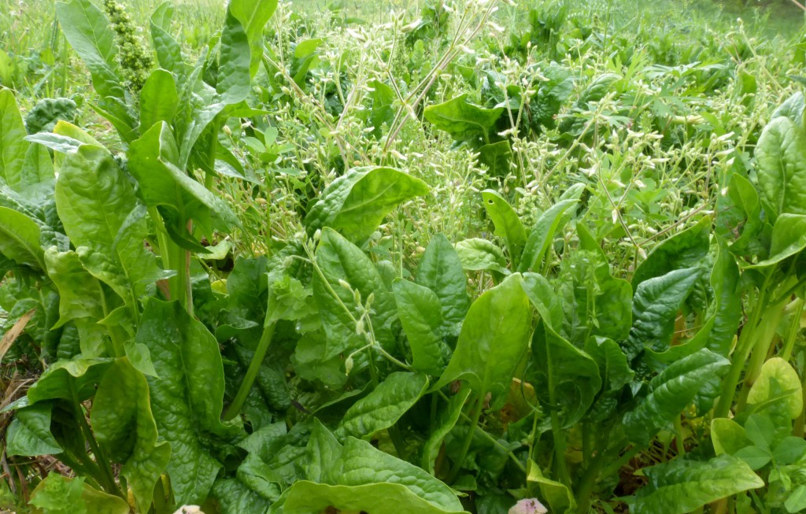
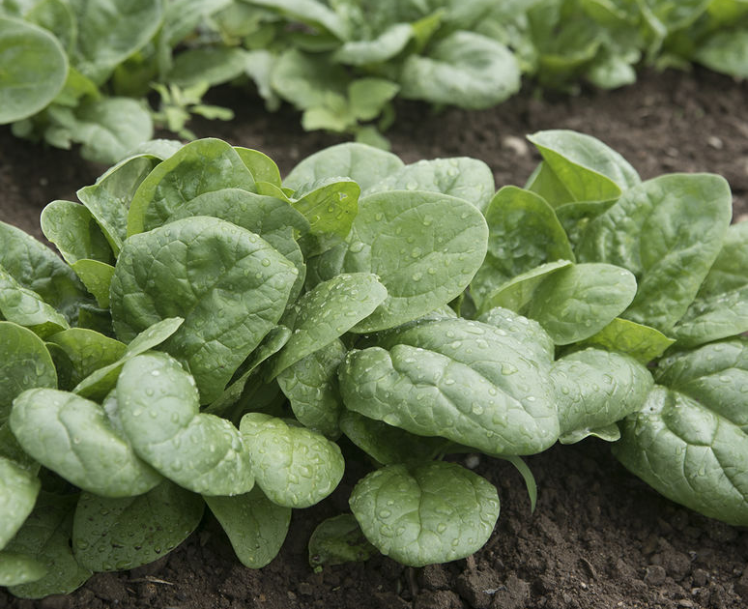
Example 1:
You love spinach, so you decide to plant continuous rounds of it every two weeks to have a consistent supply. This works great in April and May, but in June the plants start to bolt more quickly as the weather gets warmer. The leaves look yellowish and have less flavor.
You don’t see any signs of disease or pests. You look through Johnny’s options online and find a variety of spinach that can tolerate heat, and give it a go.
➔
“Seaside”
(FI)

Slide 17
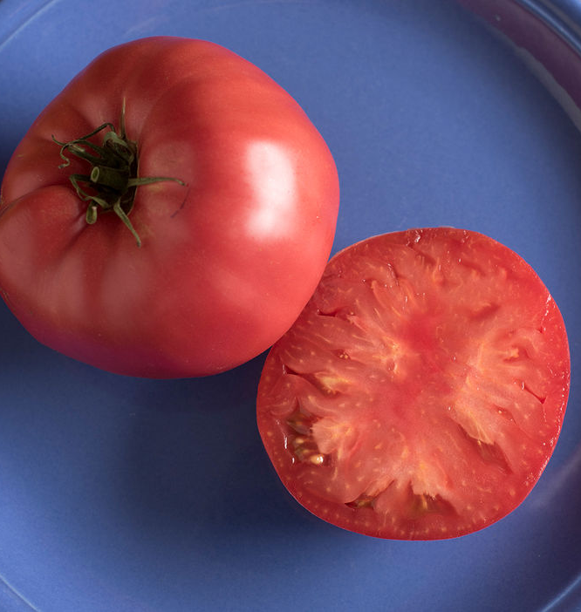
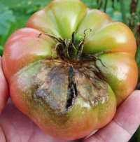
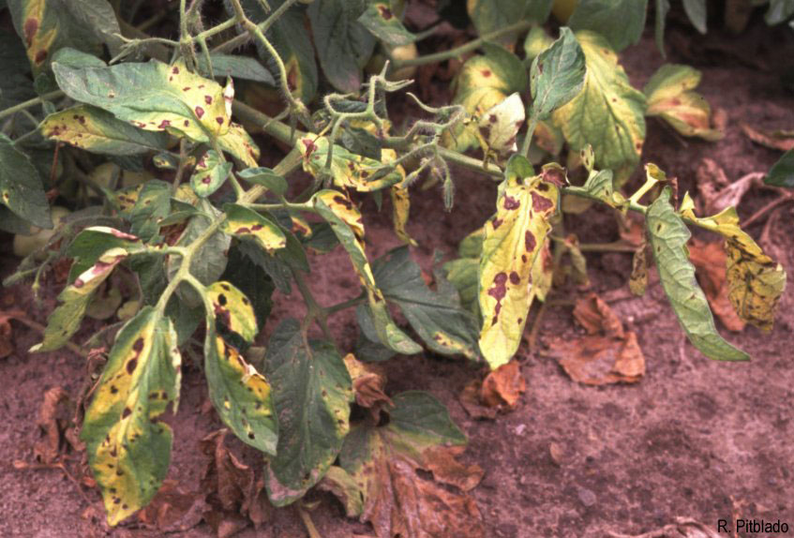
Example 2:
Last year, you grew heirloom tomatoes. You love the color and flavor, but you only got a handful of healthy fruit. The leaves turned yellow and brown, and the fruit developed brown spots. As the season went on, the spots engulfed the whole fruit, rotting them. You look up tomato diseases on OSU’s extension website, talked to your local extension agent, and concluded it was probably late blight.
➔

Slide 18
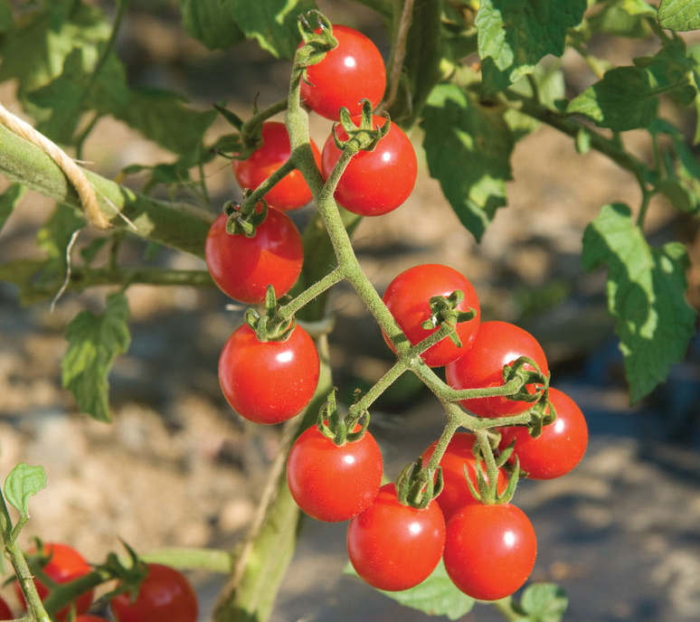
For the next year, you select hybrid tomato seeds that have resistance to late blight, and plant them in a different area of the garden. You plan on returning to the heirloom seeds in a couple years, after the pathogen has had time to die off in the soil. You remove all crop debris out of the garden so the pathogen does not have host plants to live on over winter.
(Jasper F1)

Slide 19
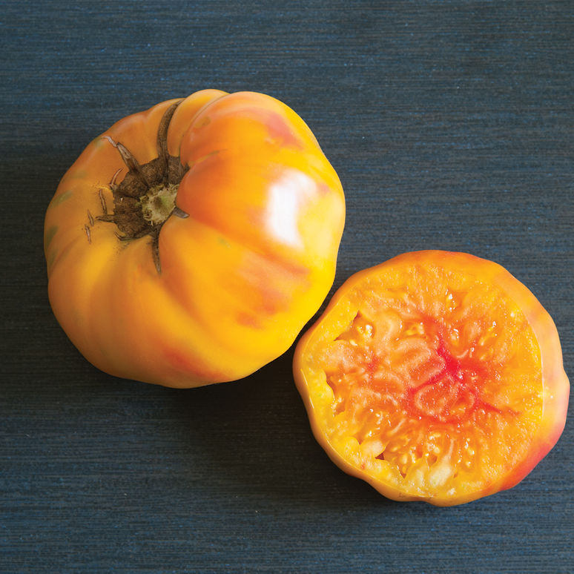
You’ve been growing a hybrid tomato variety for three years now. It’s high yielding and has low disease pressure, but you miss the flavor of the heirloom varieties. You’re only growing tomatoes for your family & friends, so you’re not trying to grow a lot of them (as compared to someone selling to market).
So, you try growing heirlooms again. This time, you choose a different type of heirloom and plant it in a new area of the garden.
You look up information about preventing late blight. You make sure not to overwater. You put down straw mulch to help with water management & weeds. You keep a lookout for any kind of disease on the plants. You prune any symptomatic material and put it far away from your garden. You rotate out of solanaceous veggies every year.

Slide 20
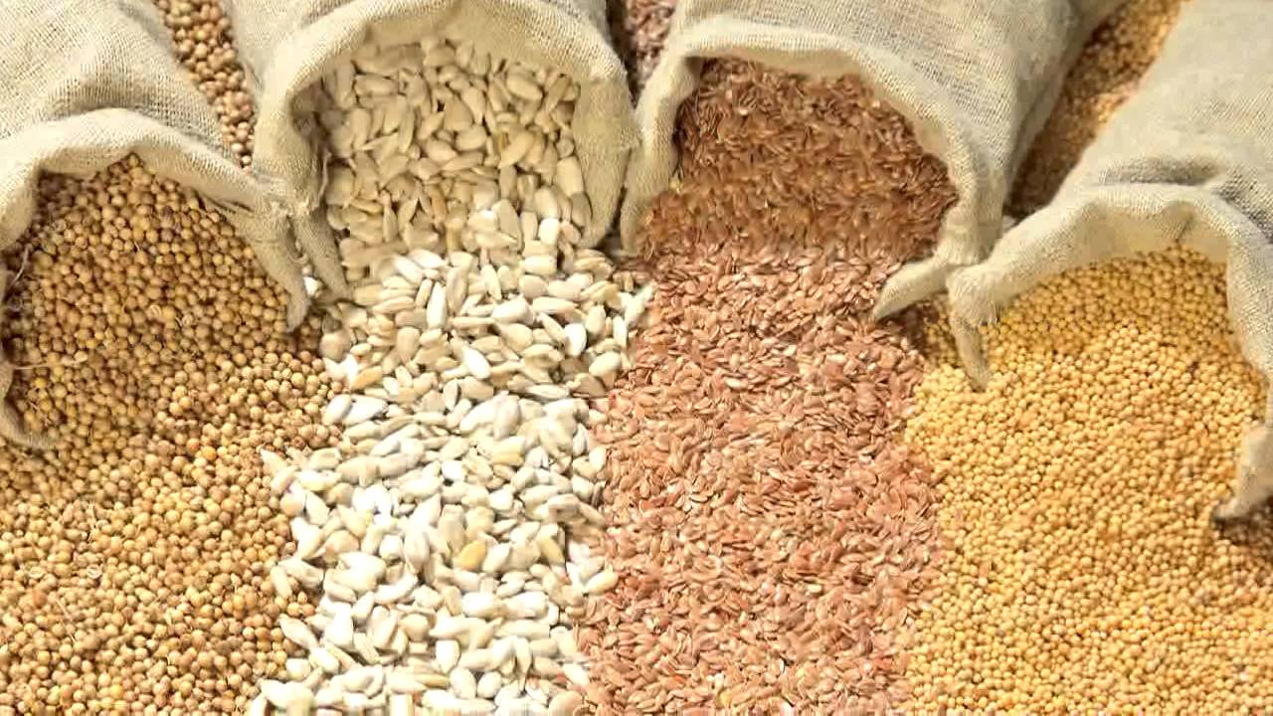
Where to find info
Extension fact sheets:
google search “extension __[topic]__”
Created by experts at land-grant universities
Seed websites: Johnny’s Selected Seed, High Mowing Seeds, Fedco Seeds, Territorial Seed Company

Slide 21
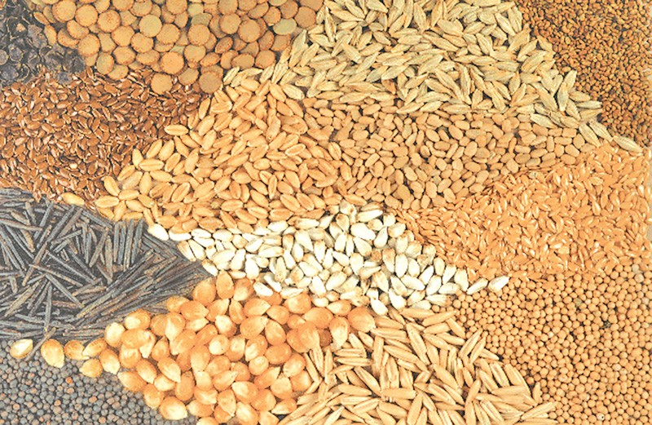
Thank you!

